Slide 1
X-Informatics Case Study: e-Commerce and Life Style Informatics: Recommender Systems II: Algorithms
February 4 2013
Geoffrey Fox
gcf@indiana.edu
http://www.infomall.org/X-InformaticsSpring2013/index.html
Associate Dean for Research and Graduate Studies, School of Informatics and Computing
Indiana University Bloomington
2013

Slide 2









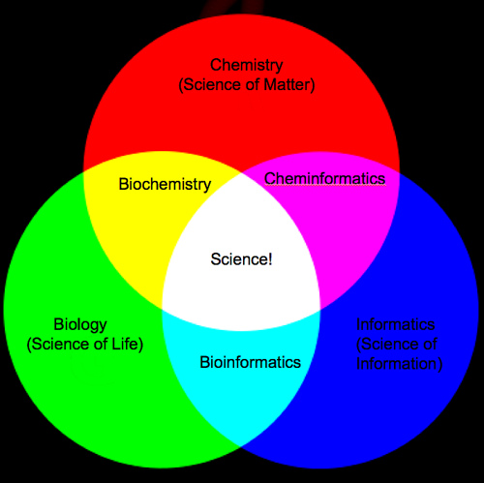
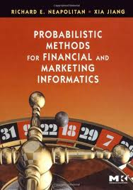

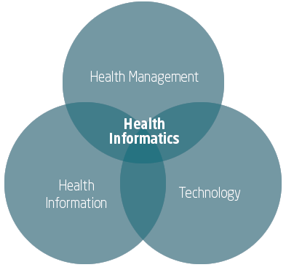
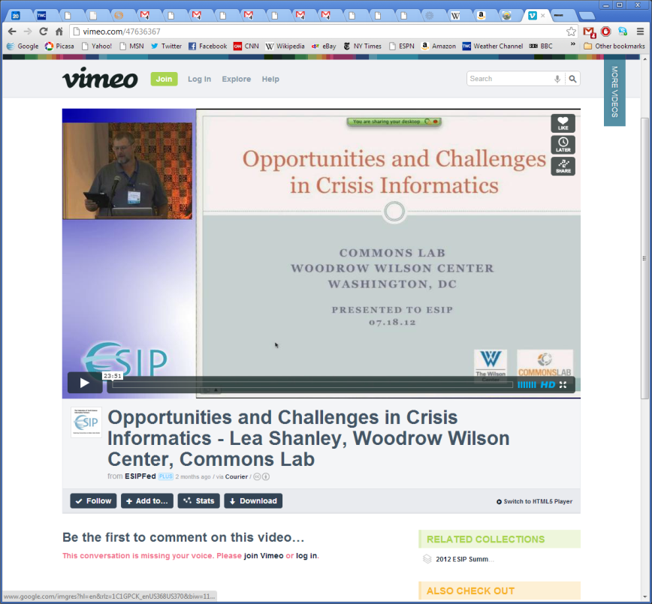

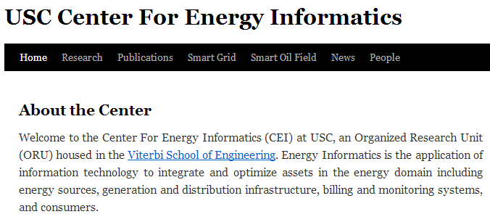
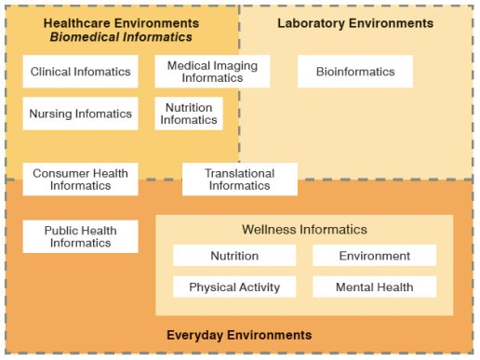
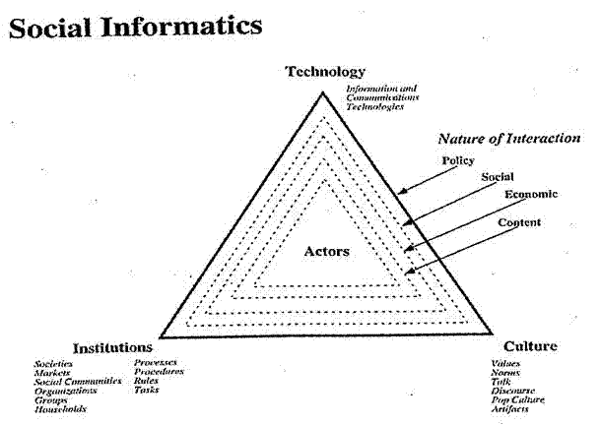


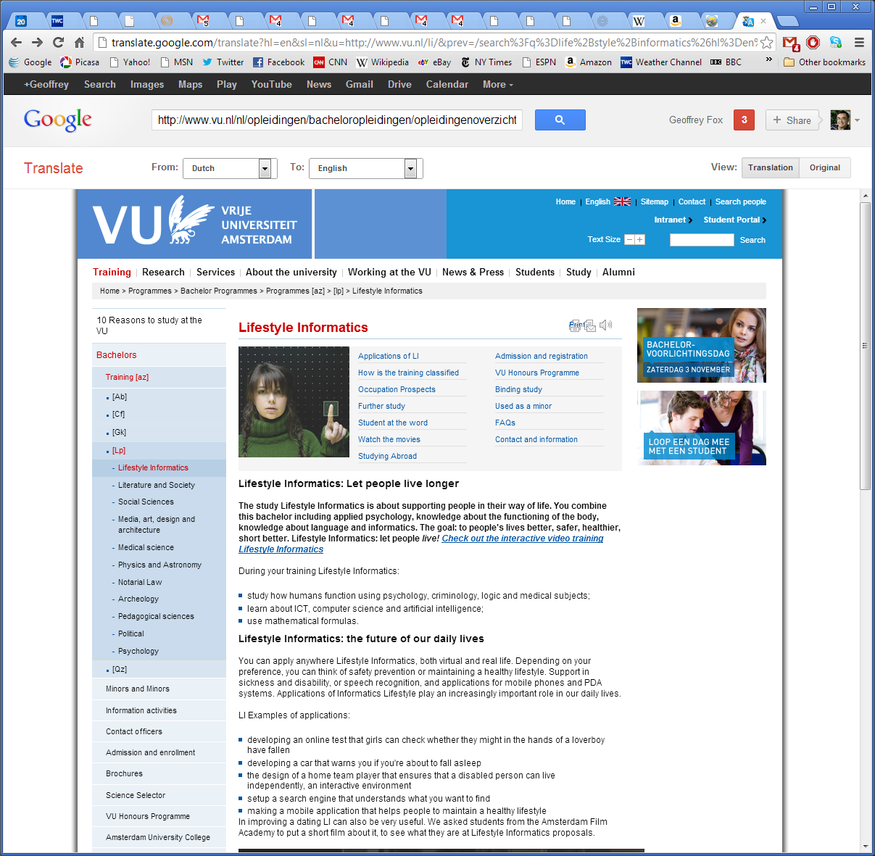


Social Informatics

Slide 3
Overview of Problems
Basic problem is personalized matching of items to people or perhaps collections of items to collections of people
People to products: Online and Offline Commerce
People to People: Social Networking
People to Jobs or Employers: Job Sites
People+Queries to the Web: Information Retrieval (search as in Bing/Google)

Slide 4
http://en.wikipedia.org/wiki/Recommender_system
When viewing a product on Amazon.com, the store will recommend additional items based on a matrix of what other shoppers bought along with the currently selected item.
Pandora uses the properties of a song or artist (a subset of the 400 attributes provided by the Music Genome Project) in order to seed a "station" that plays music with similar properties. User feedback is used to refine the station's results, deemphasizing certain attributes when a user "dislikes" a particular song and emphasizing other attributes when a user "likes" a song. This is an example of a content-based recommender system.
Last.fm creates a "station" of recommended songs by observing what bands and individual tracks that the user has listened to on a regular basis and comparing those against the listening behavior of other users. Last.fm will play tracks that do not appear in the user's library, but are often played by other users with similar interests. As this approach leverages the behavior of users, it is an example of a collaborative filtering technique.
Netflix offers predictions of movies that a user might like to watch based on the user's previous ratings and watching habits (as compared to the behavior of other users), also taking into account the characteristics (such as the genre) of the film.

Slide 5
The Google News personalization engine
http://recommenderbook.net/teaching-material/slides Chapter 2

Slide 6
Google News portal (1)
Aggregates news articles from several thousand sources
Displays them to signed-in users in a personalized way
Collaborative recommendation approach based on
the click history of the active user and
the history of the larger community
Main challenges
Vast number of articles and users
Generate recommendation list in real time (at most one second)
Constant stream of new items
Immediately react to user interaction
Significant efforts with respect to algorithms, engineering, and parallelization are required
http://recommenderbook.net/teaching-material/slides Chapter 2

Slide 7
Google News portal (2)
Pure memory-based approaches are not directly applicable and for model-based approaches, the problem of continuous model updates must be solved
A combination of model- and memory-based techniques is used
Model-based part: Two clustering techniques are used
Probabilistic Latent Semantic Indexing (PLSI) as proposed by (Hofmann 2004)
MinHash as a hashing method
Memory-based part: Analyze story co-visits for dealing with new users
Google's MapReduce technique is used for parallelization in order to make computation scalable
http://recommenderbook.net/teaching-material/slides Chapter 2

Slide 8

Example: Markdown Optimization in Retail
Department stores and fashion retailers clear apparel inventory by reducing prices
“What prices do we set through the end of the season to meet inventory goals and maximize revenue?”
In practice
Traditional pricing is based on business rules—not models
Customers respond to prices, promotions at product-store level
Weekly decisions are made at store level
Notes:
High inventory leads to deeper discounts.
Business rules constrain the decisions and affect the optimization . Stores start at the beginning of the season and decide which products to mark down (some stores do aggressive markdowns). In this example we are only looking at markdown. When modeling overall demand, the amount of data is fourfold.
The entire analysis is run each week using a moving window of two years’ data. The model is refitted and reoptimized each week. Fast business decisions require high performance computing.
The driver for an analytical approach is the volume of decisions. Some retailers reshuffle the recommendations delivered by the solution; others prefer to use “as is”.

Slide 9


Why an Analytical Solution?
Huge number of decisions
50,000 products/store x 2,000 stores = 100,000,000 decisions!
1.5 - 3 terabytes of weekly data for two-year moving window
Number of units sold, price at point of sale, reference price
Starting and ending inventory in each store
Promotions, TV ads, circulars…
Building blocks
Statistical model for demand
Price optimization
Notes:
Price is expressed as the ratio of price at point of sale to reference price
Short series (5-6 weeks) at the store-product level
Location: company → climate zones → region → market → store
Product: division → dept → class → subclass → product (sku)
Example: Division (Men’s Wear)
Department (sport or dress)
Class (shirts)
Subclass (casual, dress, formal)
SKU (product)

Slide 10
Modeling Considerations
Demand depends on
Seasonal effects, holidays
“Marketing mix” effects: price, promotion, inventory
Product life cycle effect : introduction and phase-out
Pricing rules and customer behavior are complex
Magic price points (80% is lowest markdown)
Discontinuities in response (difference between $1.99 and $2.00)
Holiday effects are confounded with promotions
Sales data are sparse for a product within a store
Notes:
Customers learn from experience that 80% is lowest markdown
Hard to identify end of season from running out of inventory
Holiday effects are confounded with promotions; what are people responding to?
Insufficient variation of factors
Low rate of sale at store-SKU
Volatility in store-SKU sales data
Short life products
Inadequate price, promotion changes at a Store-SKU to estimate impact
New products every year
Ramp-up, ramp-down effects of product introductions and phase-outs

Slide 11
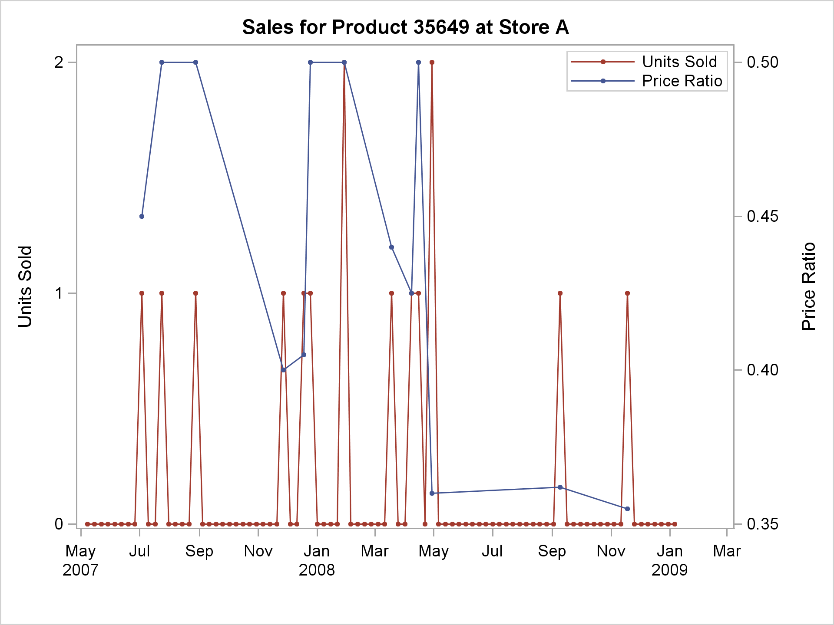
Sparse, Noisy Data at Store-Product Level

Slide 12
What Can You Do With this Data?
How do you estimate the components of demand?
The key lies in analytical hierarchies for
Products
Store locations

Slide 13
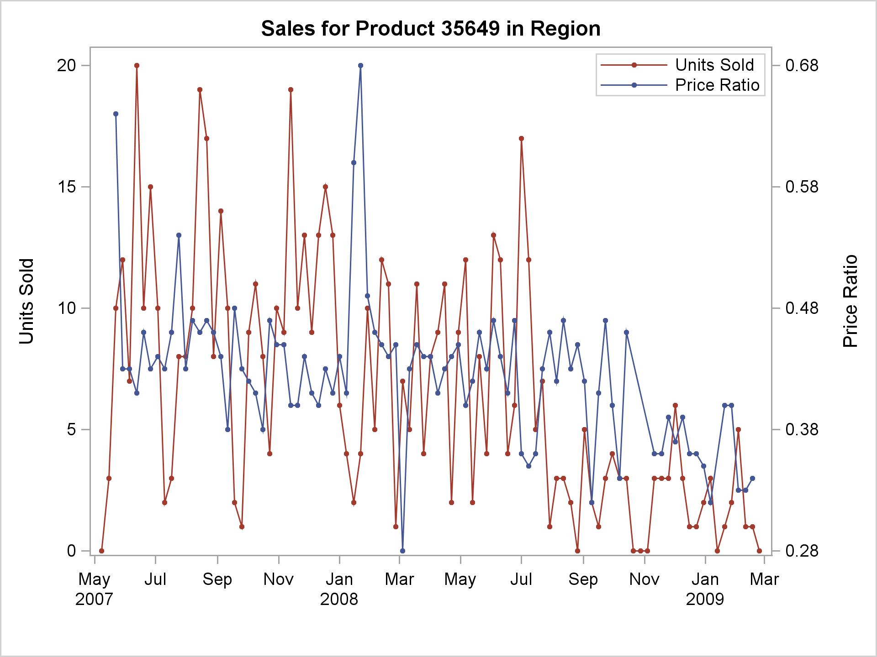
Data Aggregated at Region Level

